Slide 1
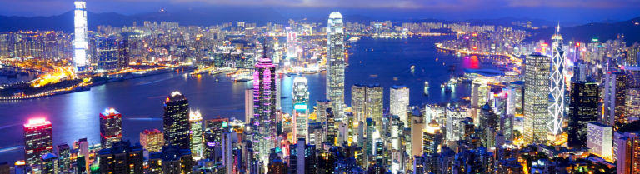
Segmenting Hong Kong MTR Station Areas

Slide 2

Introduction
On average, more than 60 million tourists visit Hong Kong every year.
MTR (Mass Transit Railway) is the most commonly used public transportation in Hong Kong.
Currently 95 heavy rail stations
Daily ridership is around five million

Slide 3
The Current Project
Segmenting MTR station areas and exploring the top venue categories in each area in Hong Kong.
Segmentation results were interpreted together with population density in different districts of Hong Kong
Objective: To provide some guidance to tourists about using the MTR system to plan their visit in Hong Kong.

Slide 4
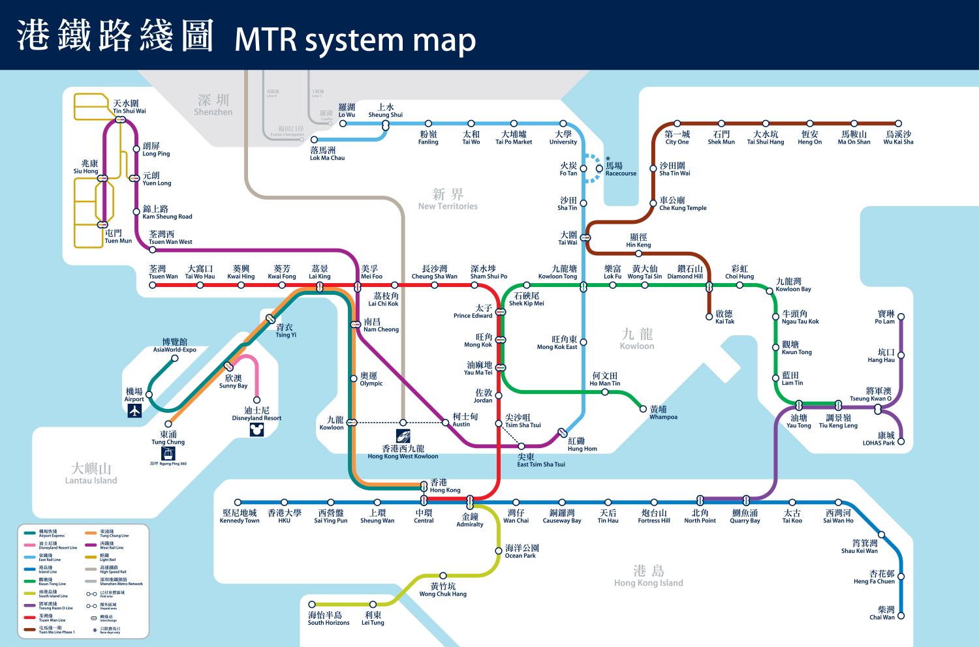
Data
A table of MTR heavy rail stations from Wikipedia (https://en.wikipedia.org/wiki/List_of_MTR_stations)
Some stations are listed for more than once because they are in multiple lines; duplicate rows will be removed.
Only the columns useful for the analysis (e.g., station name, district) will be retained

Slide 5
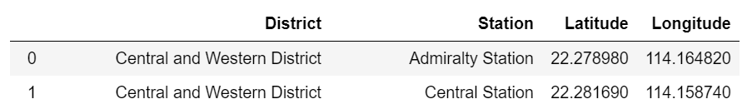
Geolocations of MTR stations
The geolocations (latitudes and longitudes) of the MTR stations were fetched with ArcGIS.
These geolocation data were merged into the table of MTR stations.

Slide 6
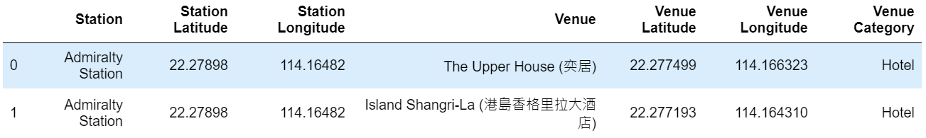
Venues in station areas
The Foursquare API was used to explore the station areas.
At maximum 200 venues within the 500-meter radius of each station were fetched.

Slide 7
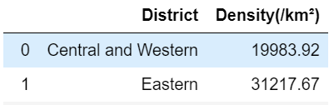
List of districts in Hong Kong
A list of Hong Kong districts was also be scraped from Wikipedia (https://en.wikipedia.org/wiki/Districts_of_Hong_Kong)
A dataframe was created to show the population densities of the 18 districts in Hong Kong.

Slide 8
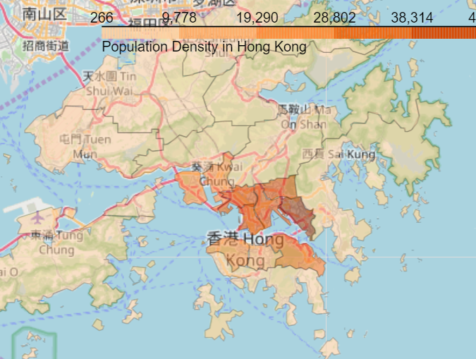
Geolocations of Hong Kong districts
The GeoJSON file provided by Esri (http://opendata.esrichina.hk/datasets/eea8ff2f12b145f7b33c4eef4f045513_0) was used to create a choropleth map to visualize the population densities in different Hong Kong districts
The clustering results were shown on the choropleth map.

Slide 9
methodology
Cluster analysis was performed to segment the different MTR station areas in Hong Kong. The MTR station areas were clustered and segmented based on the similarities and differences in the venues around them.
Procedure:
First fetched the geolocations (i.e., latitudes and longitudes) of the MTR stations in Hong Kong;
Used the Foursquare API to explore the venues around each MTR station;
The frequencies of each venue categories around each station were calculated;
K-means clustering was performed to segment the MTR station areas using the frequencies of different venue categories;
The interpretations of the k-means clustering analysis were enriched by the additional consideration of population density.

Slide 10
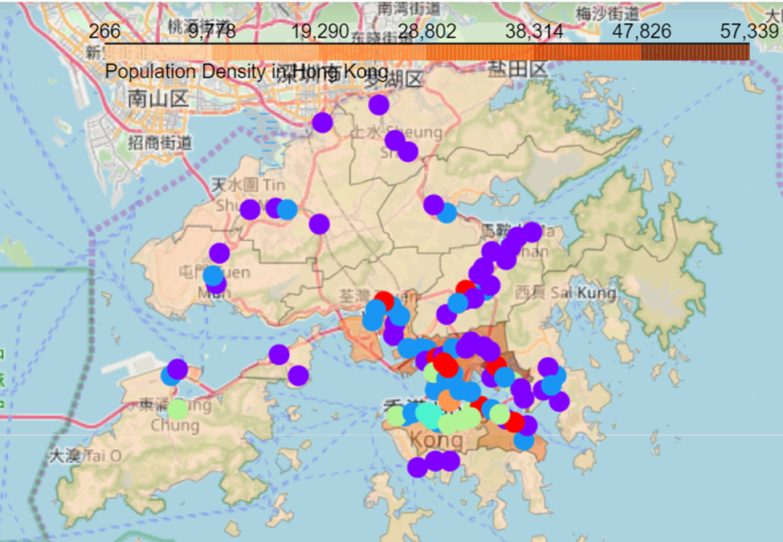
Results
Six clusters were generated and shown on the choropleth map.

Slide 11


Cluster 1 - Local Dining Spots
10 station areas (red dots in the map)
Most in the more densely populated districts of Hong Kong

Slide 12
Cluster 1 - Local Dining Spots
Top 5 most frequent venue categories
Mainly restaurants that primarily target local residents
Venue Category | Mean Frequency
Noodle house | 3.70
Chinese restaurant | 3.40
Dessert soup | 3.10
Cha chaan teng (i.e., local diners) | 2.40
Shopping mall | 2.10

Slide 13
Cluster 2 - TRANSIT Spots
43 station areas (the largest cluster; purple dots in the map)
Mostly in medium to low population density districts

Slide 14
Cluster 2 – TRANSIT Spots
Top 5 most frequent venue categories
Mainly targeting customers who are on the go
Venue Category | Mean Frequency
Fast food restaurant | 1.26
Chinese restaurant | 0.88
Shopping mall | 0.60
Coffee shop | 0.56
Bus station | 0.47

Slide 15
Cluster 3 - Local Café Spots
28 station areas (the second largest cluster; blue dots in the map)
Mostly in medium to high population density districts

Slide 16
Cluster 3 - Local Café Spots
Top 5 most frequent venue categories
Mainly targeting local customers
Similar to Cluster 2 but have more coffee shops
Venue Category | Mean Frequency
Chinese restaurant | 2.18
Coffee shop | 1.96
Café | 1.54
Fast food restaurant | 1.36
Cantonese restaurant | 1.14

Slide 17
Cluster 4 - CBD Social Spots
3 station areas (turquoise dots in the map)
Close to each other in Hong Kong Island
At the heart of the CBD

Slide 18
Cluster 4 - CBD Social Spots
Top 5 most frequent venue categories
Quite a few places for people to mingle and socialize
Venue Category | Mean Frequency
Japanese restaurant | 4.67
Coffee shop | 4.67
Cocktail bar | 4.67
Café | 4.00
Bar | 4.00

Slide 19
Cluster 5 - Convenient Accommodation Spots
9 station areas (green dots in the map)
Most of which are located on the Hong Kong Island

Slide 20
Cluster 5 - Convenient Accommodation Spots
Top 5 most frequent venue categories
Similar to Cluster 4 in that both contain quite a few Japanese restaurants and coffee shops
But Cluster 5 have more hotels
Venue Category | Mean Frequency
Coffee shop | 4.78
Japanese restaurant | 3.78
Café | 3.44
Chinese restaurant | 3.44
Hotel | 2.56

Slide 21
Cluster 6 - Central Touristy Spots
2 station areas (orange dots in the map)
Very close to each other in Tsim Sha Tsui in Kowloon on the Victoria Harbor

Slide 22
Cluster 6 - Central Touristy Spots
Top 5 most frequent venue categories
Many hotels and restaurants that target foreign travelers
Venue Category | Mean Frequency
Hotel | 9.00
Japanese restaurant | 8.00
Hotel bar | 5.00
Steakhouse | 4.00
Shopping mall | 3.50

Slide 23
Discussion
Six clusters of MTR station areas in Hong Kong, that is, Local Dining Spots, Transit Spots, Local Café Spots, CBD Social Spots, Convenient Accommodation Spots, and Central Touristy Spots
Local Dining Spots: Many restaurants or eateries that serve local residents
Visitors who are interested in authentic local food at affordable prices should visit these station areas.
Transit Spots: Restaurants and cafés that target customers on the go
Visitors will find it easy to grab a bite quickly if they happen to visit these areas on the way to other places.

Slide 24
Discussion
Local Café Spots: Many cafés that mainly serve local customers
Visitors to these places can enjoy coffee at reasonable prices
CBD Social Spots: More high-end restaurants and cafés
Visitors can visit these places if they prefer something fancier
Convenient Accommodation Spots: Many hotels on Hong Kong Island; close to CBD
Central Touristy Spots: Many hotels in Tsim Sha Tsui, a major tourist attraction on the Victoria Harbor (the Kowloon side)

Slide 25
Conclusion
The clustering results will help visitors to Hong Kong to better plan their stay in Hong Kong using the MTR system.
Future directions: More focused clustering analysis
For example, the different MTR station areas can be clustered based on the density of sports facilities or the density of parks in order to provide more tailored recommendations for travelers who are interested in visiting areas with particular characteristics.

Slide 26
Thank you!

